Slide 1

Distributed Data Mining
DIADIC Lab
Sandipan Dey

Slide 2
Problems
Randomized construction of distributed decision tree (collaborative text classifier)
Outlier Detection
- Parallel (Hadoop based)
- P2P (DDMT / erlang)
PADMini System

Slide 3
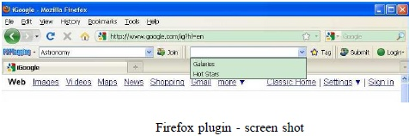
P2P Collaborative Text Classifier
Tag Text through plugin
Generate feature vector
Learn Classifier
Centralized – privacy issue

Slide 4

Randomized Distributed Decision Tree Learning
Greedy decision / synchronization overhead
Random construction of trees (Wei Fan), ensemble learning
Simple averaging

Slide 5
Randomized Distributed Decision Tree Learning
Sample (WR) from population
Locally generate RDTs
Compute leaf class distributions
Asynchronously (gossip) compute average posterior probability

Slide 6


Accuracy of the Ensemble
Ensemble acc.= N = #RDTs, p = accuracy of an RDT
Generalization Error of ensemble Classifier (Leo Breiman, Random Forest)

Slide 7
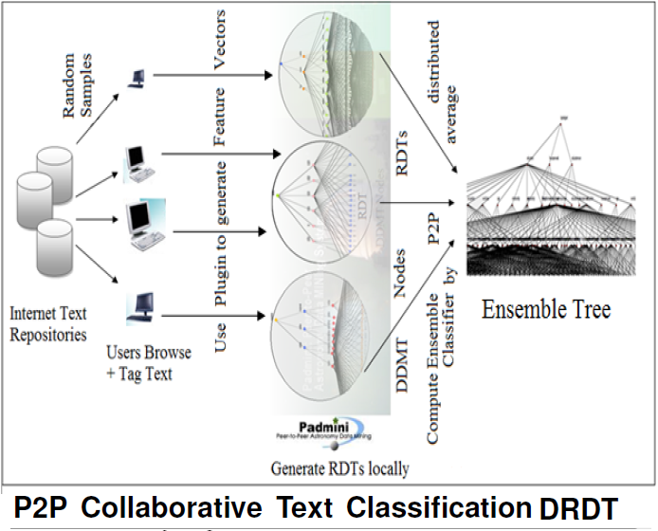

Slide 8
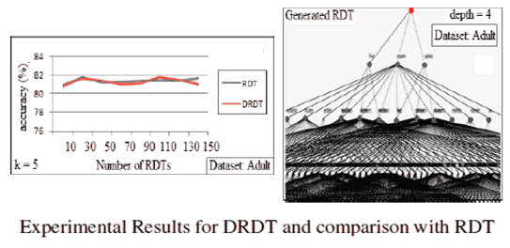

Slide 9
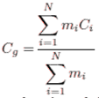

Distributed Outlier Detection
in PADMini (using Hadoop)
Couple of Map-Reduce Phases
Use Eigen Analysis to find outliers
Use additive decomposability of covariance matrix
Compute outlier score for each tuple

Slide 10
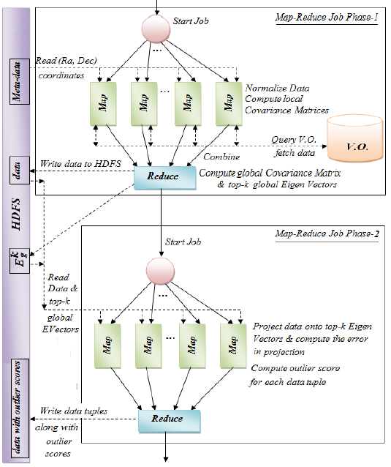

Slide 11
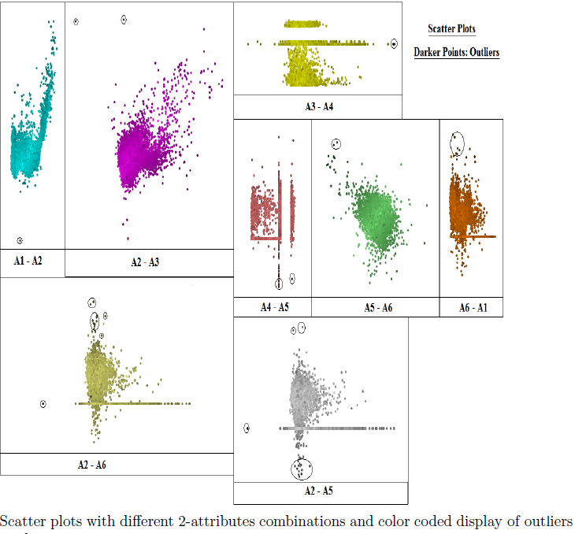

Slide 12
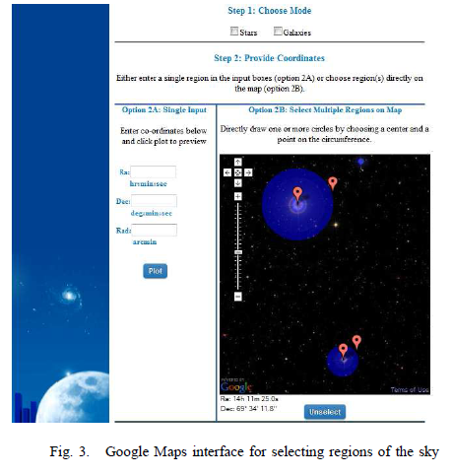

Slide 13

Distributed Outlier Detection
Using Entropy Minimization / Spectral Decomposition – define Outlierness
Combining local eigenvectors to form global eigenvectors
How to find weights?

Slide 14

Chrome Extension P2P Commenting

Slide 15
Thank You

